Slide 1
INT362
CLOUD ARCHITECTURE AND IMPLEMENTATION - I
Setting up a Zone
Setting up a Pod
Setting up a Cluster
Setting up a Host

Slide 2
Zones
A CloudStack Zone (often called Availability Zone) is the largest organisational unit within a CloudStack deployment. Typically, a datacentre (DC) implementation will contain a single Zone, but there are no hard and fast rules, and a DC can contain multiple Zones. By structuring CloudStack into geographical Zones, virtual instances and data storage can be placed in specific locations to comply with an organisation’s data storage policies etc.
A Zone consists of at least one Pod, and Secondary Storage which is shared by all Pods in the Zone.
Zones are visible to end users, who can then choose which Zone they wish to create their virtual Instances in.
Pods
Typically, a Pod relates to a discrete rack in a datacentre so that from CloudStack a whole rack/pod of hosts can be taken offline for maintenance as a group. Pods contain one or more Clusters, and a Layer 2 switch architecture which is shared by all Clusters in that Pod. End users are not aware of and have no visibility of Pods.

Slide 3
Clusters
A Cluster is a group of identical Hosts running a common Hypervisor. For example, a Cluster could be a XenServer Pool, a group of KVM Servers or a VMware cluster pre- configured in vCenter. Each Cluster has a dedicated Primary Storage array which is where the virtual machine instances are hosted.
Primary Storage
Primary Storage is usually unique to each Cluster (although it could also be used Zone- wide) and is used to host Instances. CloudStack is designed to work with all standards- compliant iSCSI and NFS Servers supported by the underlying Hypervisor. Special storage solutions are also supported (such as CEPH, ScaleIO, SolidFire, etc). Primary Storage is a critical component and should be built on high-performance hardware with multiple high- speed disks.
Secondary Storage
Secondary Storage is used to store Instance Templates, ISO images and Volume Snapshots. The storage is available to all PODs in a Zone. Secondary Storage uses the Network File System (NFS) as this ensures it can be accessed by any Host in the Zone.
Instances
An Instance is a virtual machine that can be created by the end-user of CloudStack. Instances are based on Instance Templates and Service Offerings which specify the size (vCPU & RAM).

Slide 4
Allow the “root” user for SSH access using password, by editing /etc/ssh/sshd_config and ensuring there is a line “PermitRootLogin yes”. Restart ssh daemon. Change and remember the root password, test remote access using SSH for the “root” user:
passwd root
systemctl stop ufw; systemctl disable ufw

Slide 5
Hostname
CloudStack requires that the hostname is properly set. If you used the default options in the installation, then your hostname is currently set to localhost.localdomain. To test this, we will run:
# hostname --fqdn
At this point it will likely return:
localhost
To rectify this situation - we’ll set the hostname (we are using “server.local” in our example)
hostnamectl set-hostname server.local --static
After you’ve modified that file restart:
# reboot
Now recheck with the
# hostname --fqdn
and ensure that it returns a FQDN response.

Slide 6
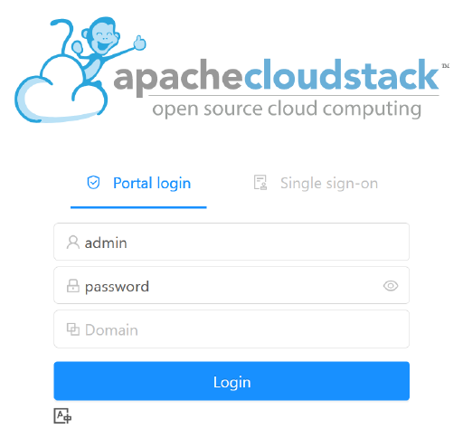
Configuration: UI ACCESS
To get access to CloudStack’s web interface, point your browser to the IP address of your machine e.g. http://192.168.1.2:8080/client
The default username is ‘admin’, and the default password is ‘password’. ——->>> Login

Slide 7
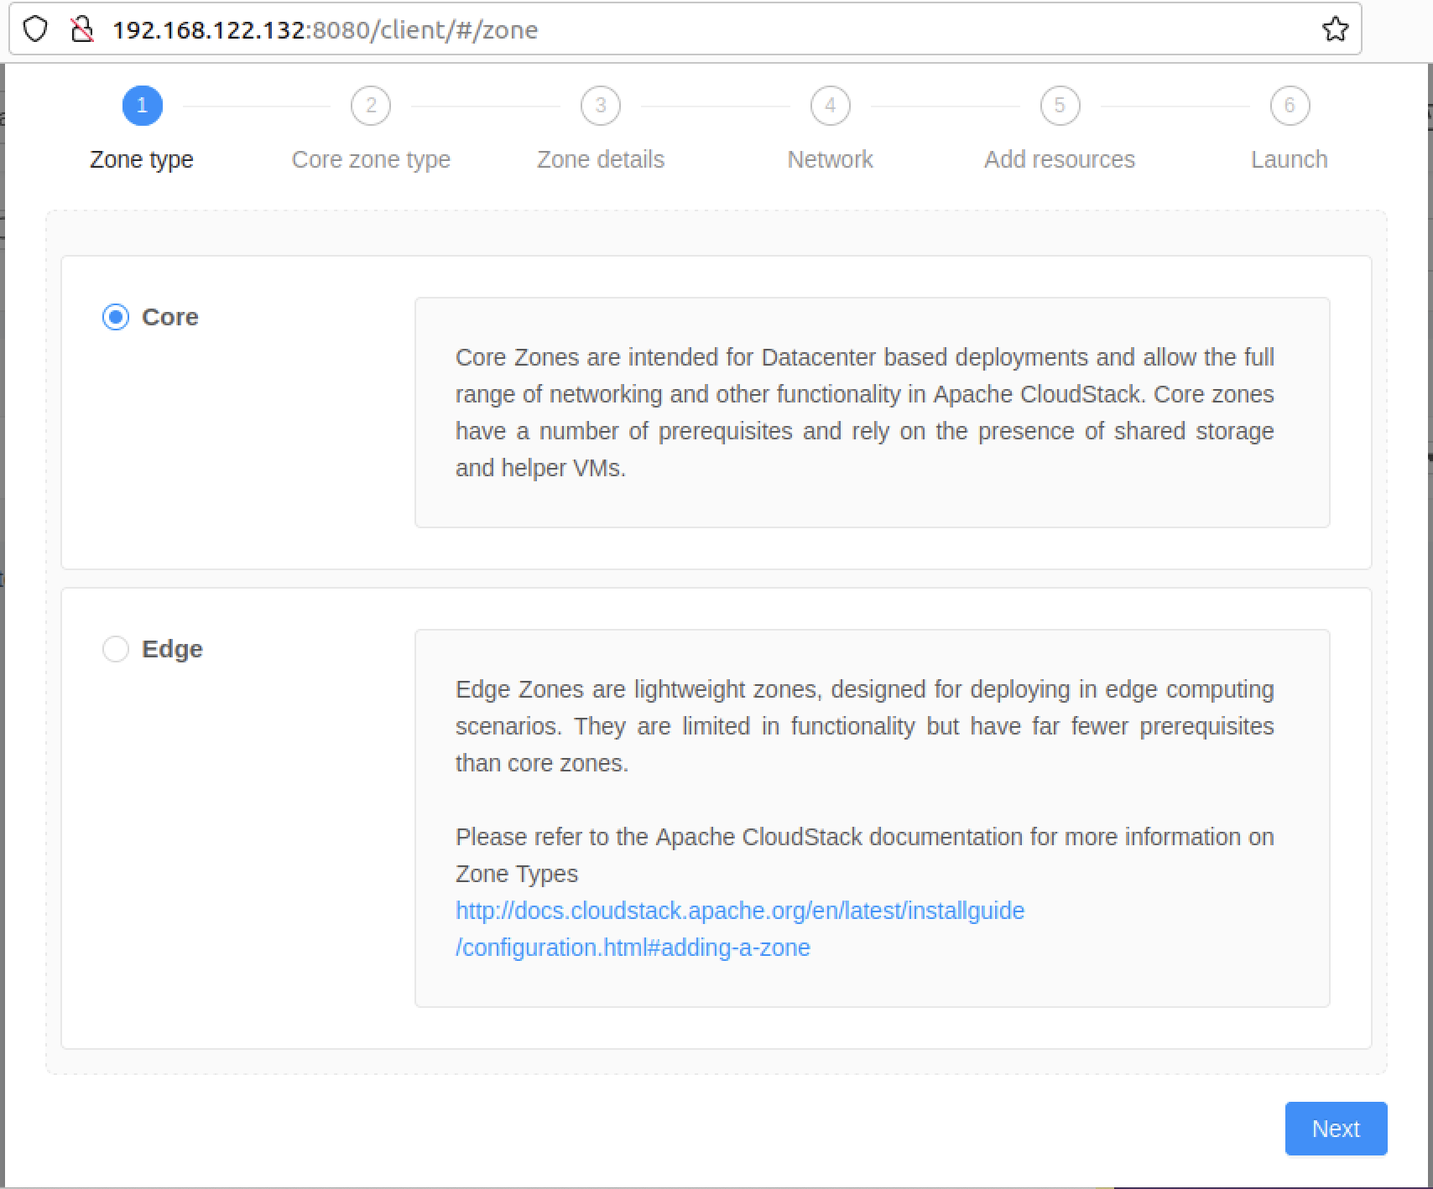
Setting up a Zone:
Go to Infrastructure → Zone and click on “add zone” button.
Select “Core”, click on ‘Next’
Select “Advanced zone” and provide the following configuration (leaving all other defaults):

Slide 8
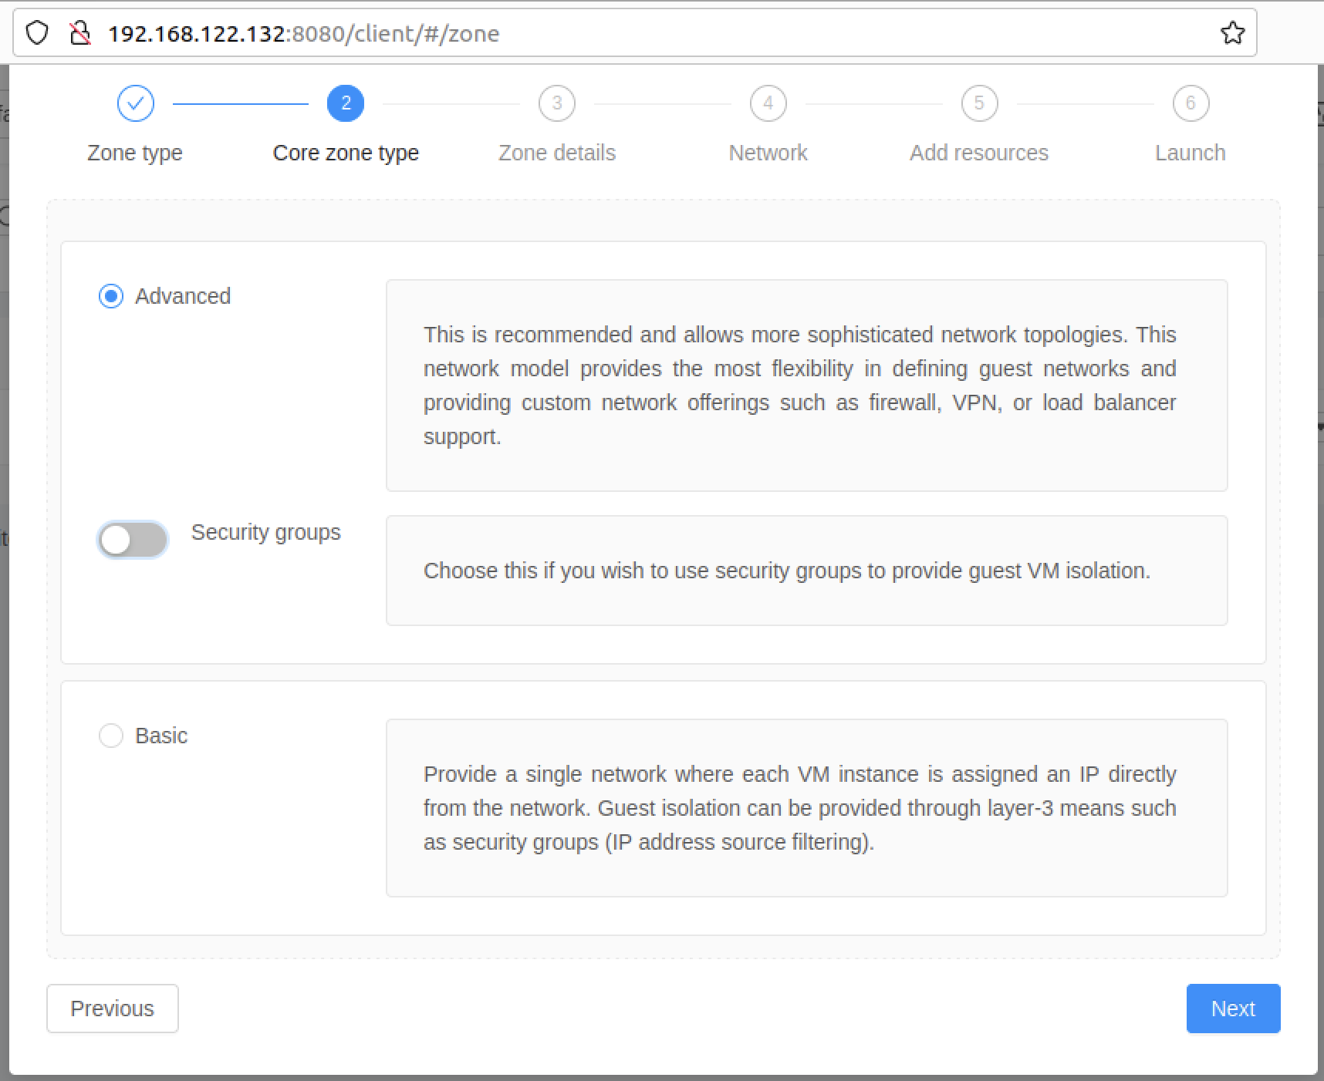

Slide 9
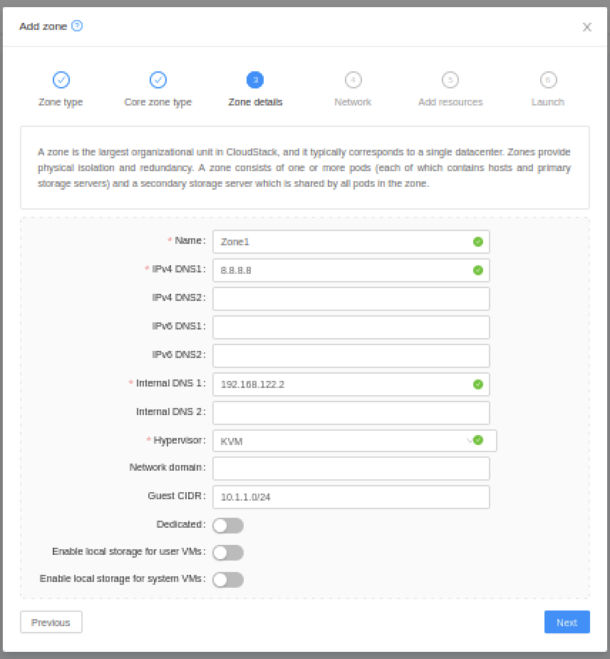

Name : Zone1
IPV4 : 8.8.8.8
Internal DNS 1 : 192.168.122.2
This is your gateway ip
Hypervisor : KVM

Slide 10
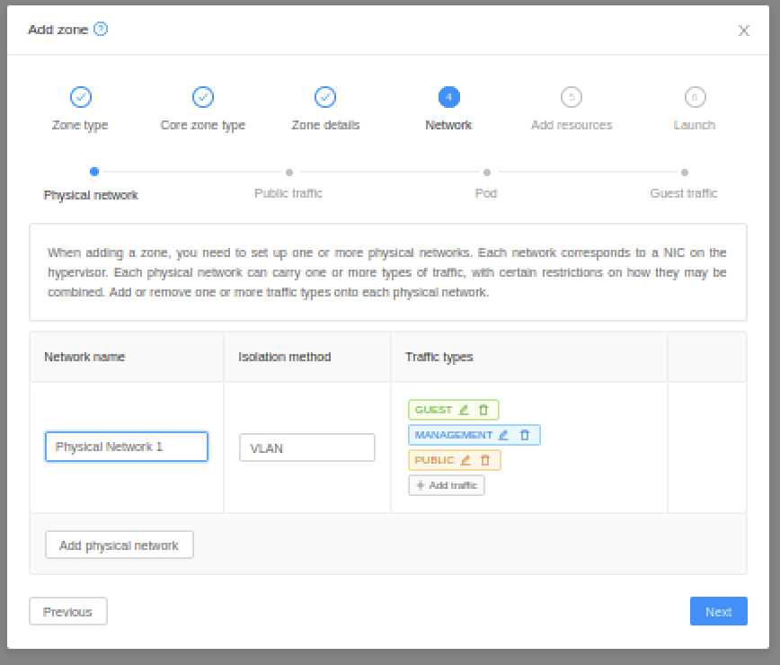
Setting up a Network:
On the next screen (Physical network details), use the defaults – we will use the VLAN isolation method on a single physical NIC (on the host) that will carry all traffic types (management, public, guest) and
click “Next”.

Slide 11
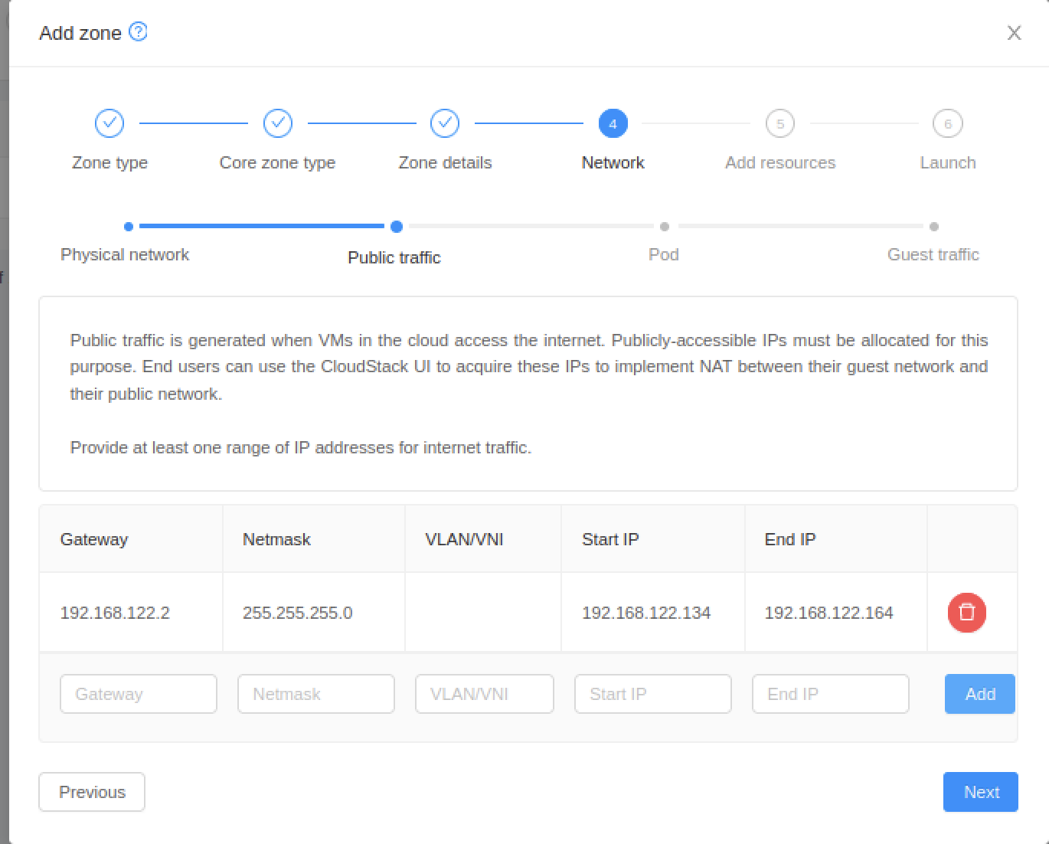
Public traffic configuration:
Gateway - 192.168.122.2
(your VM gateway) Netmask - 255.255.255.0 VLAN/VNI - leave blank Start IP - 192.168.122.134 End IP - 192.168.122.164 Click on the “Add” button,
click on “Next”

Slide 12
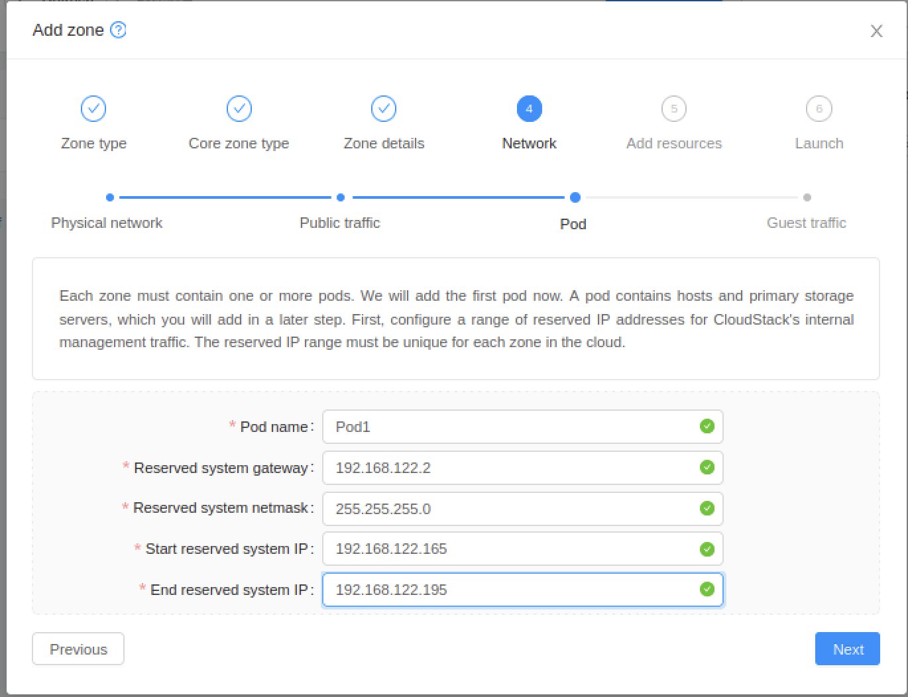
Pod Configuration:
Name – e.g. Pod1 Reserved system gateway - 192.168.122.2
Reserved system netmask - 255.255.255.0
Start reserved system IP - 192.168.122.165
Start reserved system IP - 192.168.122.195
Click on “Next”

Slide 13
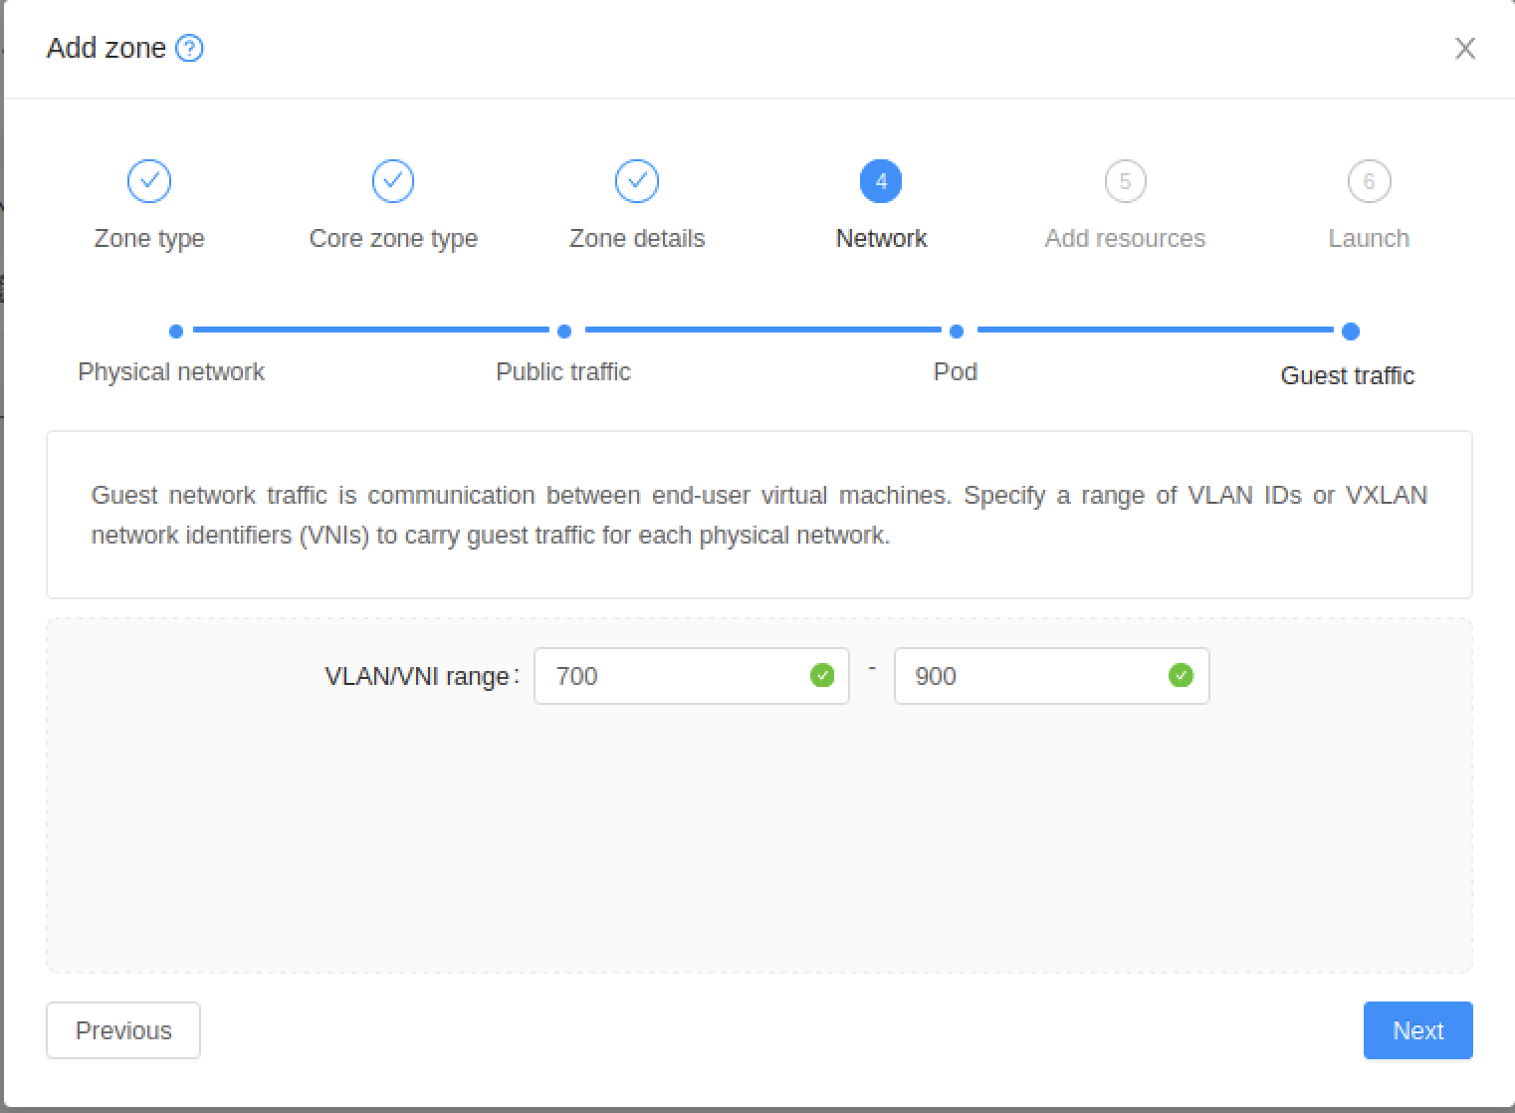
Guest traffic:
VLAN/VNI range:
700-900
Click on “Next”

Slide 14
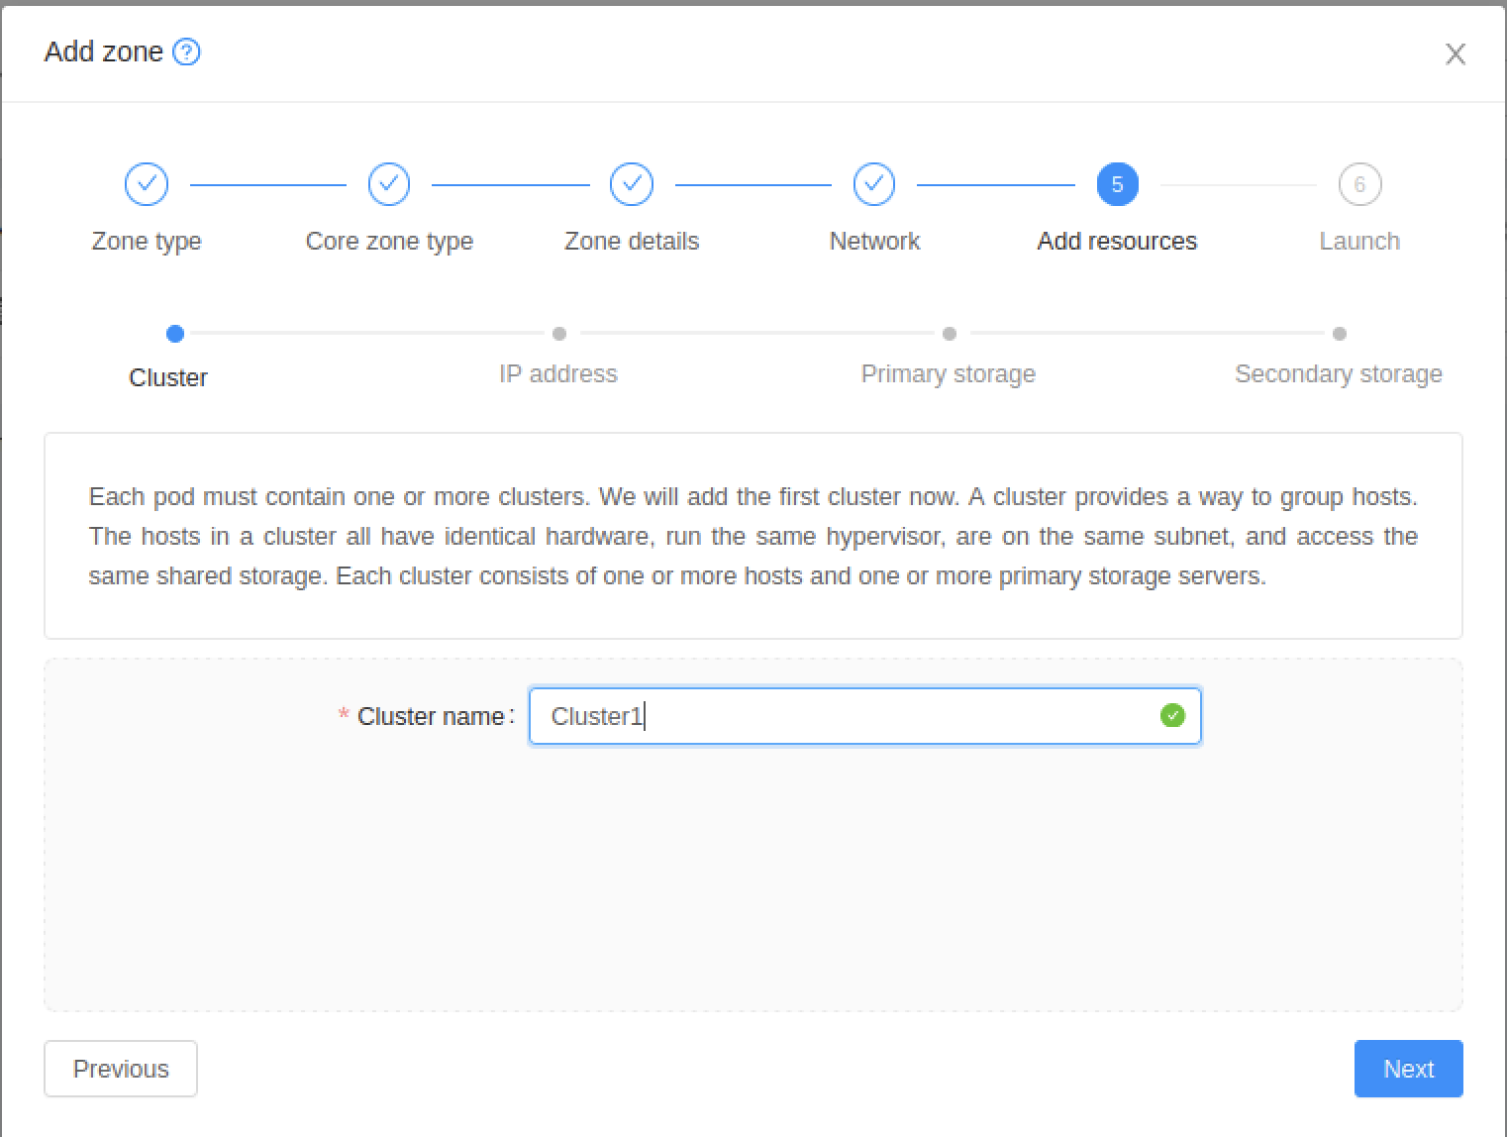
Create a cluster with the following:
Name – e.g. Cluster1
Click on “Next”

Slide 15
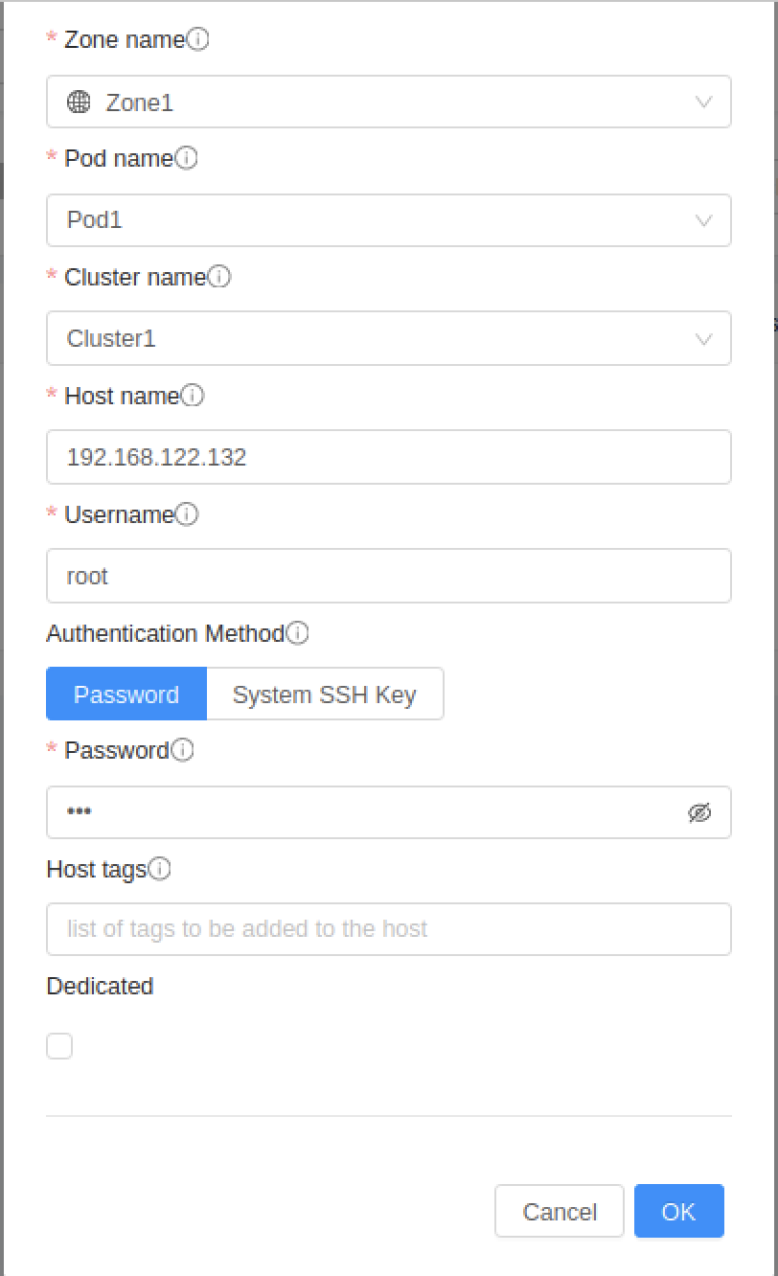
Add your default/first host:
Hostname - 192.168.122.132
( IP for virtual machine)
Username - root Password - <password for root user> Click on “Next”

Slide 16
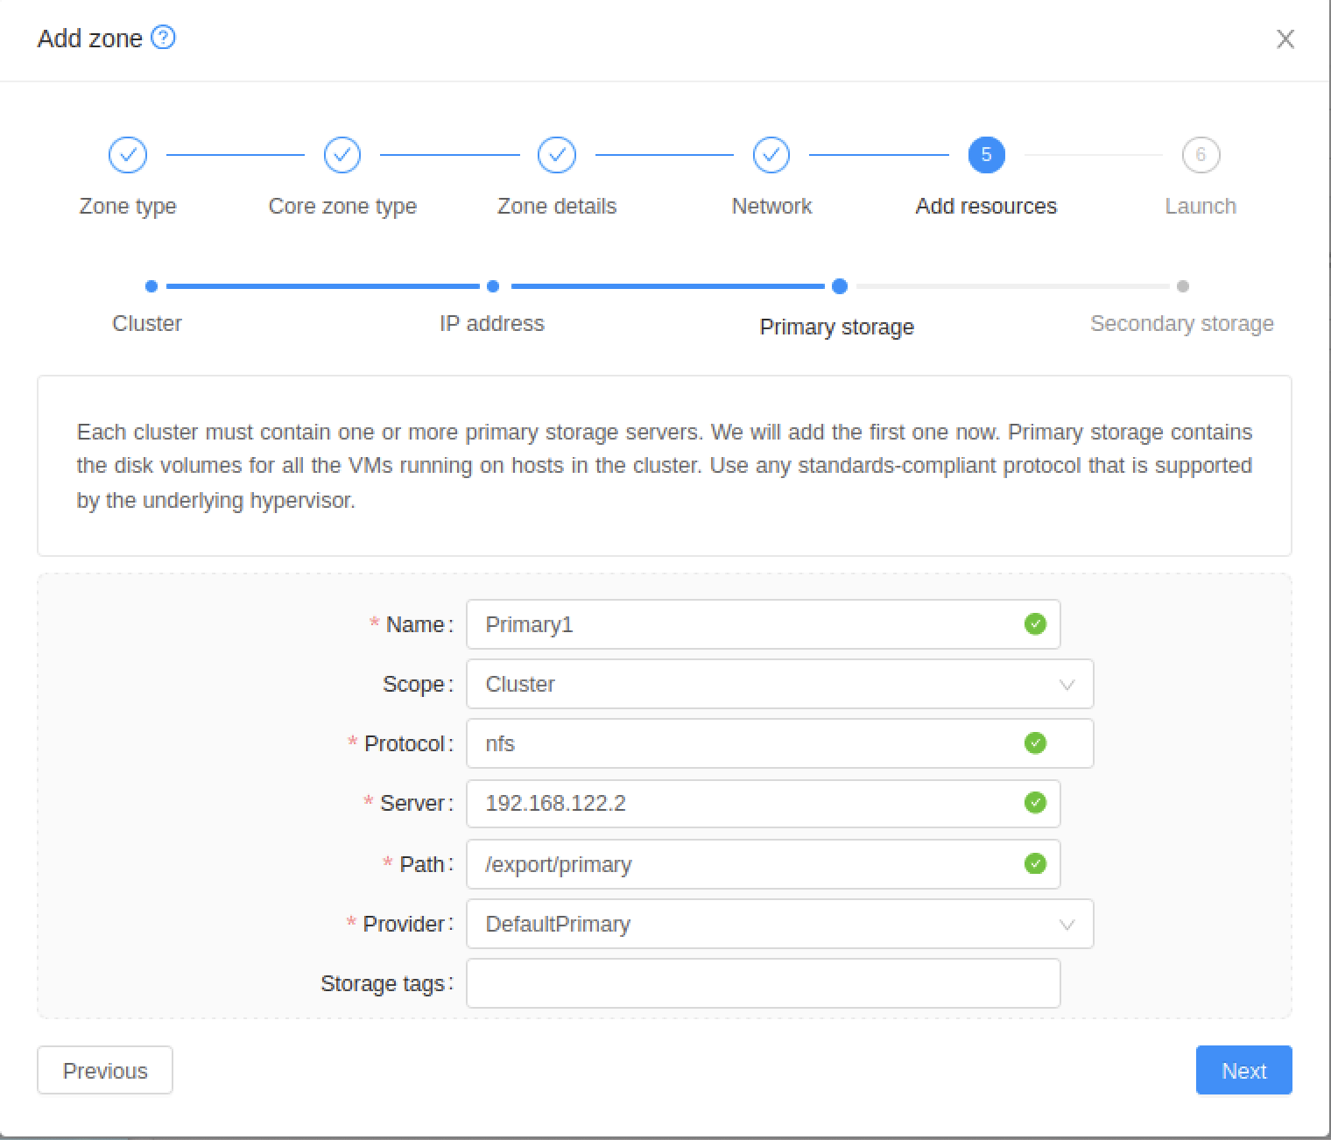
Add primary storage:
Name – e.g. Primary1
Scope - Zone / Cluster Protocol - NFS Server - 192.168.122.2
(or whatever IP you have set up for this machine)
Path - /export/primary
Click on “Next”

Slide 17
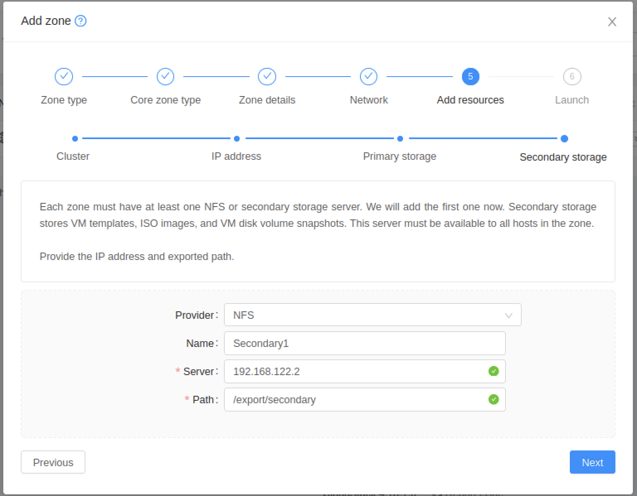
Add secondary storage:
Provider - NFS
Name – e.g. Secondary1 Server - 192.168.122.2
(or whatever IP you have set up for this machine)
Path - /export/secondary
Click on “Next”

Slide 18
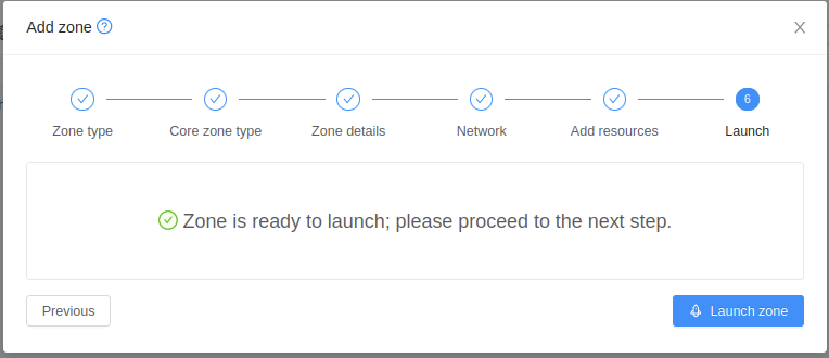

Slide 19
